Slide 1
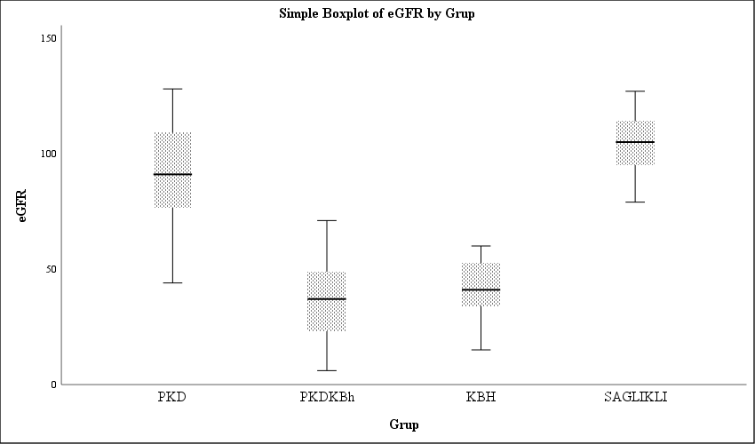
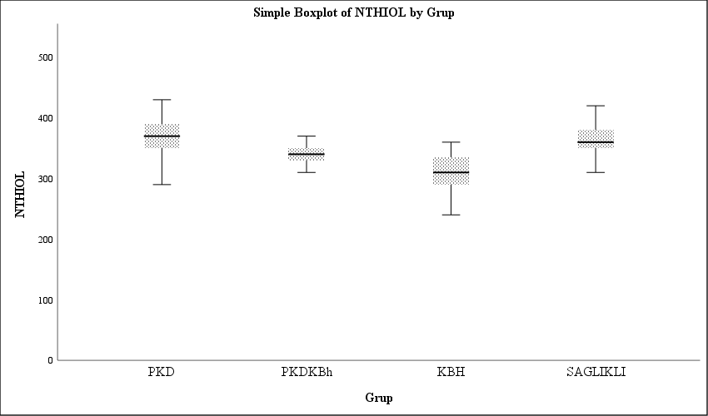
Investigation of Thiol Disulfide Balance in People with Polycystic Kidney and Chronic Kidney Disease
Aleyna Yazıcı¹, Şahabettin Selek²
¹Bezmialem Vakıf University, Faculty of Medicine, Istanbul, Turkey.
² Bezmialem Vakıf University, Faculty of Medicine, Department of Medical Biochemistry, Istanbul, Turkey.
Introduction:
Autosomal dominant polycystic kidney disease (ADPKD) is an inherited multisystem disease characterized by progressive cystic enlargement of the kidneys. Proteinuria is the most sensitive marker of chronic kidney disease progression in clinical practice, especially when combined with eGFR, but they have limitations. Therefore, early, more sensitive biomarkers are required. Oxidative stress refers to the in vivo oxidation of lipids, proteins, carbohydrates and DNA and involves many biochemical pathways. Thiol / disulfide homeostasis is a marker of oxidative stress,We think that total and native thiol, which will be examined in the serum of patients with polycystic kidney disease and chronic kidney disease, will be an important marker in elucidating the pathogenesis, determining the prognosis, and the results obtained by comparing it with routinely used parameters will make a great contribution to the clinicians.
Methods:
With the power analysis performed, it was calculated that 3 groups (with the 50 patient diagnosis of Polycystic Kidney Disease, 50 patient Chronic Kidney Disease and 50 healthy volunteers) were included for the study. Total and native thiol levels in the serum samples taken will be measured in the Bezmialem Vakıf University Faculty of Medicine Medical Biochemistry Routine Laboratory with the new method developed by Erel et al in the autoanalyzer device.
Results:
As a result, the levels of thiol and native thiol, known as antioxidants, differed significantly between the patients with chronic kidney disease and polycystic kidney and the healthy control group (p<0,05). It has been shown that chronic kidney disease is associated with thiol levels (p<0,0045).Glomerular filtration rate was found to be lower in patients with chronic kidney disease than healthy volunteers(p<0,05). Glomerular filtration rate is not significant between cases with polycystic kidneys and healthy volunteers. Our study is a study in which thiol levels were investigated in patients with chronic kidney disease and polycystic kidney, compared with healthy volunteers, and the results were found to be significant.
Conclusion:
In this study, the results were found to be significant by comparing thiol levels in patients diagnosed with chronic kidney disease and polycystic kidney disease with healthy volunteers.
References:
1. Willey CJ, Blais JD, Hall AK, Krasa HB, Makin AJ, Czerwiec FS. Prevalence of autosomal dominant polycystic kidney disease in the European Union. Nephrology Dialysis Transplantation. 2017;32(8):1356-63.
2. Reeders ST, Breuning MH, Davies KE, Nicholls RD, Jarman AP, Higgs DR, et al. A highly polymorphic DNA marker linked to adult polycystic kidney disease on chromosome 16. Nature. 1985;317(6037):542-4.
3. Colbert GB, Elrggal ME, Gaur L, Lerma EV. Update and review of adult polycystic kidney disease. Disease-a-Month. 2020;66(5):100887.
4. Hogan MC, Abebe K, Torres VE, Chapman AB, Bae KT, Tao C, et al. Liver involvement in early autosomal-dominant polycystic kidney disease. Clinical Gastroenterology and Hepatology. 2015;13(1):155-64.e6.
5. Farooq Z, Behzadi AH, Blumenfeld JD, Zhao Y, Prince MR. Complex liver cysts in Autosomal Dominant Polycystic Kidney Disease. Clinical
ANOVA
 |  | Sum of Squares | df | Mean Square | F | Sig.
TTHIOL | Between Groups | 199264,740 | 3 | 66421,580 | 57,593 | ,000
 | Within Groups | 221433,219 | 192 | 1153,298
 | Total | 420697,959 | 195
NTHIOL | Between Groups | 81787,016 | 3 | 27262,339 | 40,818 | ,000
 | Within Groups | 120890,822 | 181 | 667,905
 | Total | 202677,838 | 184
eGFR | Between Groups | 167998,077 | 3 | 55999,359 | 208,648 | ,000
 | Within Groups | 50994,340 | 190 | 268,391
 | Total | 218992,418 | 193

